Slide 1
Interprocess Communication

Slide 2
Objectives
To describe the various features of processes, including scheduling, creation and termination, and communication
To explore interprocess communication
To describe communication in client-server systems

Slide 3
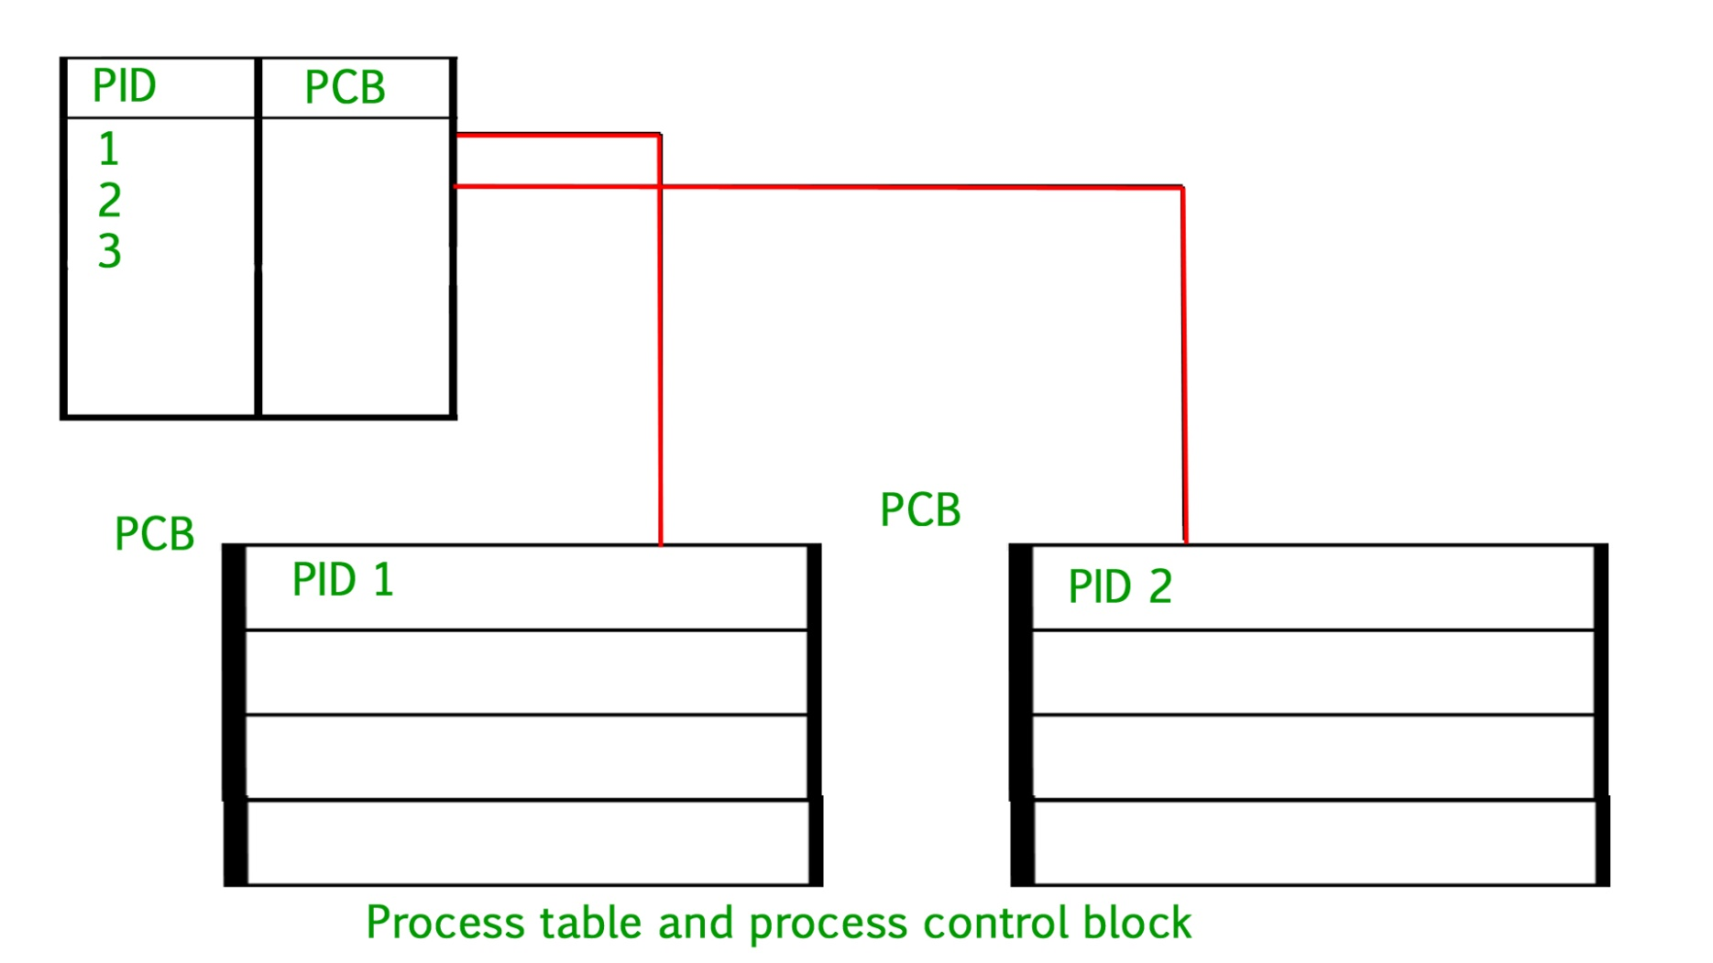
Process Control Block

Slide 4
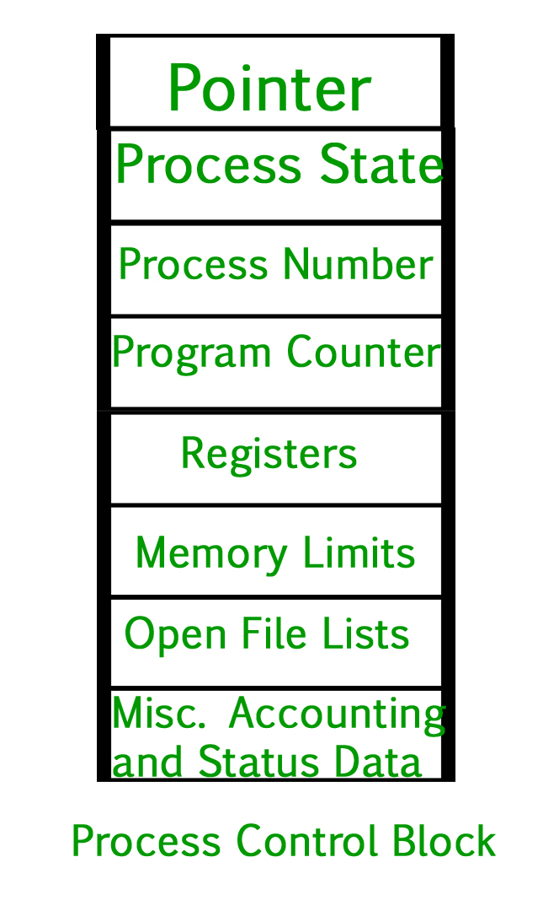
Process Control Block
Pointer – It is a stack pointer which is required to be saved when the process is switched from one state to another to retain the current position of the process.
Process state – It stores the respective state of the process.
Process number – Every process is assigned with a unique id known as process ID or PID which stores the process identifier.
Program counter – It stores the counter which contains the address of the next instruction that is to be executed for the process.
Register – These are the CPU registers which includes: accumulator, base, registers and general purpose registers.
Memory limits – This field contains the information about memory management system used by operating system. This may include the page tables, segment tables etc.
Open files list – This information includes the list of files opened for a process.

Slide 5

Process Control Block (PCB)
Information associated with each process
Process state – running, waiting, etc
Program counter – location of instruction to next execute
CPU registers – contents of all process-centric registers
CPU scheduling information- priorities, scheduling queue pointers
Memory-management information – memory allocated to the process
Accounting information – CPU used, clock time elapsed since start, time limits
I/O status information – I/O devices allocated to process, list of open files

Slide 6

CPU Switch From Process to Process

Slide 7
Threads
So far, process has a single thread of execution
Consider having multiple program counters per process
  Multiple locations can execute at once
    Multiple threads of control -> threads
Must then have storage for thread details, multiple program counters in PCB

Slide 8

Process Representation in Linux
Represented by the C structure task_struct
pid t_pid; /* process identifier */
long state; /* state of the process */
unsigned int time_slice /* scheduling information */
struct task_struct *parent; /* this process’s parent */
struct list_head children; /* this process’s children */
struct files_struct *files; /* list of open files */
struct mm_struct *mm; /* address space of this process */

Slide 9
Process Scheduling
Maximize CPU use, quickly switch processes onto CPU for time sharing
Process scheduler selects among available processes for next execution on CPU
Maintains scheduling queues of processes
  Job queue – set of all processes in the system
  Ready queue – set of all processes residing in main memory, ready and waiting to execute
  Device queues – set of processes waiting for an I/O device
  Processes migrate among the various queues

Slide 10

Ready Queue And Various I/O Device Queues

Slide 11

Representation of Process Scheduling
Queueing diagram represents queues, resources, flows

Slide 12
Schedulers
Short-term scheduler (or CPU scheduler) – selects which process should be executed next and allocates CPU
  Sometimes the only scheduler in a system
  Short-term scheduler is invoked frequently (milliseconds) ⇒ (must be fast)
Long-term scheduler (or job scheduler) – selects which processes should be brought into the ready queue
  Long-term scheduler is invoked infrequently (seconds, minutes) ⇒ (may be slow)
  The long-term scheduler controls the degree of multiprogramming
Processes can be described as either:
  I/O-bound process – spends more time doing I/O than computations, many short CPU bursts
  CPU-bound process – spends more time doing computations; few very long CPU bursts
Long-term scheduler strives for good process mix

Slide 13

Addition of Medium Term Scheduling
Medium-term scheduler can be added if degree of multiple programming needs to decrease
  Remove process from memory, store on disk, bring back in from disk to continue execution: swapping

Slide 14
Process Swapping
Swap-in: Transfer from secondary storage back into RAM.
Swap-out: from RAM to secondary storage.
Advantages:
  Improved memory utilization
  Virtual memory creation
  Priority based scheduling
Disadvantages:
  Performance
  Data loss risk
  Increased page faults

Slide 15
Multitasking in Mobile Systems
Some mobile systems (e.g., early version of iOS) allow only one process to run, others suspended
Due to screen real estate, and user interface limits iOS provides
  Single foreground process- controlled via user interface
  Multiple background processes– in memory, running, but not on the display, and with limits
  Limits include single, short task, receiving notification of events, specific long-running tasks like audio playback

Slide 16
Multitasking in Mobile Systems (cont.)
Android runs foreground and background, with fewer limits
  Background process uses a service to perform tasks
  Service can keep running even if background process is suspended
  Service has no user interface, small memory use

Slide 17
Context Switch
When CPU switches to another process, the system must save the state of the old process and load the saved state for the new process via a context switch
Context of a process represented in the PCB
Context-switch time is overhead; the system does no useful work while switching
  The more complex the OS and the PCB ➔ the longer the context switch
Time dependent on hardware support
  Some hardware provides multiple sets of registers per CPU ➔ multiple contexts loaded at once

Slide 18
Operations on Processes
System must provide mechanisms for:
  process creation,
  process termination,
  and so, on as detailed next

Slide 19
Process Creation
Parent process create children processes, which, in turn create other processes, forming a tree of processes
Generally, process identified and managed via a process identifier (pid)
Resource sharing options
  Parent and children share all resources
  Children share subset of parent’s resources
  Parent and child share no resources
Execution options
  Parent and children execute concurrently
  Parent waits until children terminate

Slide 20

C Program Forking Separate Process

Slide 21
Process Termination
Process executes last statement and then asks the operating system to delete it using the exit() system call.
  Returns status data from child to parent (via wait())
  Process’ resources are deallocated by operating system
Parent may terminate the execution of children processes using the abort() system call. Some reasons for doing so:
  Child has exceeded allocated resources
  Task assigned to child is no longer required
  The parent is exiting and the operating systems does not allow a child to continue if its parent terminates

Slide 22
Process Termination
Some operating systems do not allow child to exists if its parent has terminated. If a process terminates, then all its children must also be terminated.
  cascading termination. All children, grandchildren, etc. are terminated.
  The termination is initiated by the operating system.

Slide 23
Process Termination (cont.)
The parent process may wait for termination of a child process by using the wait()system call. The call returns status information and the pid of the terminated process
pid = wait(&status);
If no parent waiting (did not invoke wait()) process is a zombie
If parent terminated without invoking wait , process is an orphan

Slide 24
Multiprocess Architecture – Chrome Browser
Many web browsers ran as single process (some still do)
  If one web site causes trouble, entire browser can hang or crash
Google Chrome Browser is multiprocess.

Slide 25

Multiprocess Architecture – Chrome Browser (cont.)
Google Chrome Browser has 3 different types of processes:
  Browser process manages user interface, disk and network I/O
  Renderer process renders web pages, deals with HTML, Javascript. A new renderer created for each website opened
    Runs in sandbox restricting disk and network I/O, minimizing effect of security exploits
  Plug-in process for each type of plug-in

Slide 26
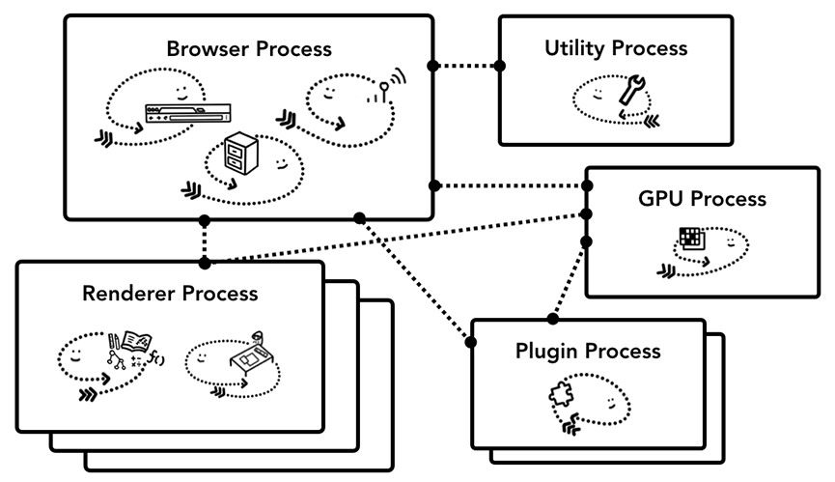
Multiprocess Architecture – Chrome Browser (cont.)

Slide 27
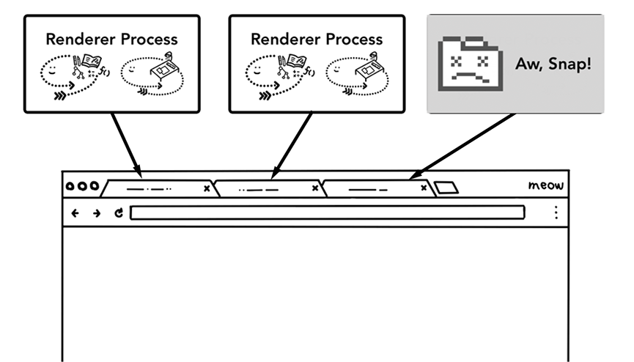
Multiprocess Architecture – Chrome Browser (cont.)

Slide 28
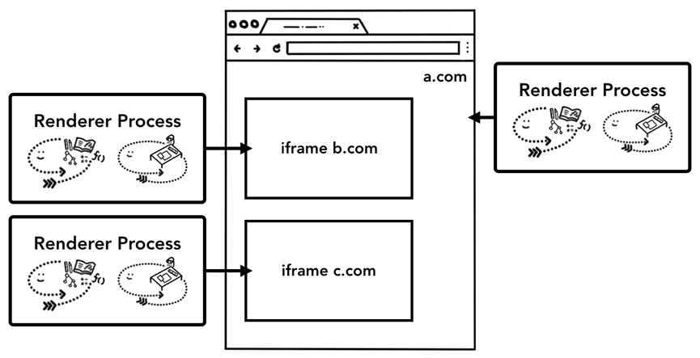
Multiprocess Architecture – Chrome Browser (cont.)
Multiple renderers

Slide 29
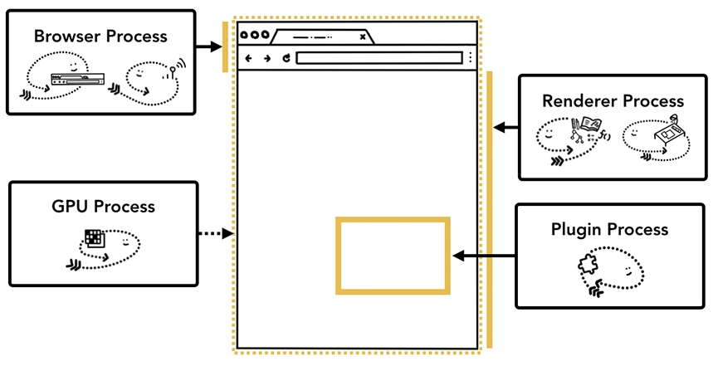
Multiprocess Architecture – Chrome Browser (cont.)
Different processes pointing to different parts of the bowser UI

Slide 30
Interprocess Communication
Processes within a system may be independent or cooperating
Cooperating process can affect or be affected by other processes, including sharing data
Reasons for cooperating processes:
  Information sharing
  Computation speedup
  Modularity
Cooperating processes need interprocess communication (IPC)
Two models of IPC
  Shared memory
  Message passing

Slide 31

Communications Models
(a) Message passing. (b) shared memory.

Slide 32
Cooperating Processes
Independent process cannot affect or be affected by the execution of another process
Cooperating process can affect or be affected by the execution of another process
Advantages of process cooperation
  Information sharing
  Computation speed-up
  Modularity

Slide 33
fork() and pipe()
What if we want to support the following:
  ls –la | sort
One process should execute ls –la and another should execute sort
By default, a command such as ls requires that its output goes to standard output. This means the terminal (stdout)
The sort command requires a file be provided as a command line argument from standard input (stdin)

Slide 34
Possible Solution
int pid;
pid = fork();
if (pid<0) {
perror("Problem forking");
exit(1);
} else if (pid>0) {
execlp("ls","ls","-la", NULL);
perror("exec problem");
exit(1);
} else {
execlp("sort","sort",NULL);
perror("exec problem");
exit(1);
}
return(0);
}

Slide 35
Example (cont.)
Why does it not work?
The output of the ls –la goes to the terminal
We wanted it to be the input to the sort

Slide 36
Pipes
Acts as a conduit allowing two processes to communicate
Issues:
  Is communication unidirectional or bidirectional?
  In the case of two-way communication, is it half or full-duplex?
  Must there exist a relationship (i.e., parent-child) between the communicating processes?
  Can the pipes be used over a network?

Slide 37
Pipes (cont.)
Ordinary pipes – cannot be accessed from outside the process that created it. Typically, a parent process creates a pipe and uses it to communicate with a child process that it created.
Named pipes – can be accessed without a parent-child relationship.

Slide 38
Ordinary Pipes
Ordinary Pipes allow communication in standard producer-consumer style
Producer writes to one end (the write-end of the pipe)
Consumer reads from the other end (the read-end of the pipe)

Slide 39

Ordinary Pipes(cont.)
Ordinary pipes are therefore unidirectional
Require parent-child relationship between communicating processes
Windows calls these anonymous pipes

Slide 40
Communications in Client-Server Systems
Sockets
Remote Procedure Calls
Pipes
Remote Method Invocation (Java)

Slide 41
Interprocess Communication
Pipes
  Used to allow processes on the same machine to communicate with each other
  One process spawns the other
Sockets
  Processes can be on different machine

Slide 42
IPC Mechanisms
Pipes
  Processes on the same machine
  Allows parent process to communicate with child process
  Allows two “sibling” processes to communicate
  Used mostly for a pipeline of filters
Sockets
  Processes on any machines
  Processes created independently
  Used for client/server communication (e.g., Web)
Both provide abstraction of an “ordered stream of bytes”

Slide 43
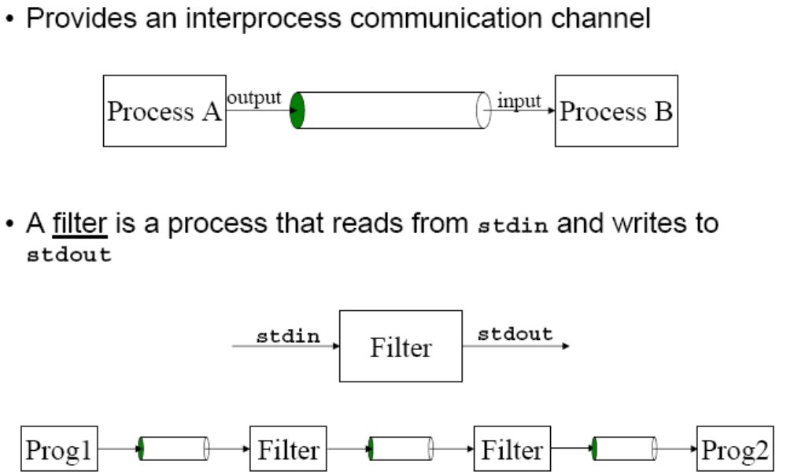
Pipes

Slide 44
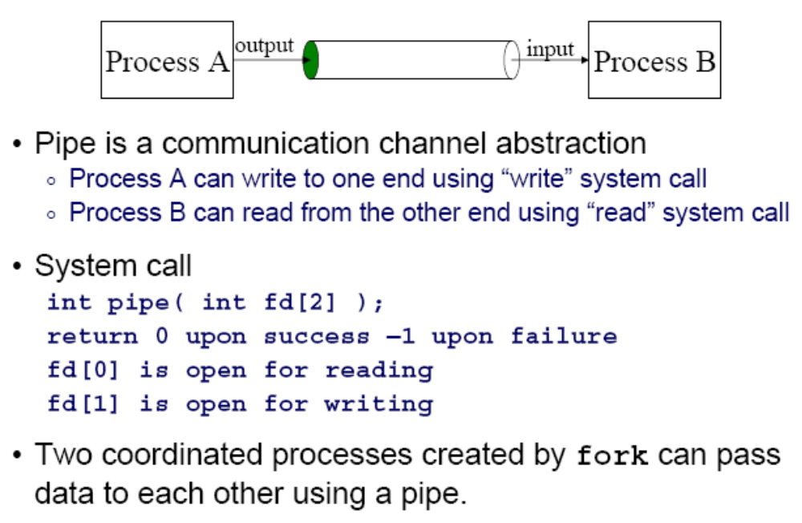
Creating a Pipe

Slide 45
Redirection
Unix allows redirection of stdin, stdout, or stderr
How?
  Use open(), creat(), and close() system calls
    Described in I/O Management lecture
  Use dup() system call…
int dup(int oldfd);
    Create a copy of the file descriptor oldfd. After a successful return from dup() or dup2(), the old and new file descriptors may be used interchangeably. They refer to the same open file description and thus share file offset and file status flags. Uses the lowest-numbered unused descriptor for the new descriptor. Return the new descriptor, or -1 if an error occurred.

Slide 46
Redirection Example
How does shell implement “somepgm > somefile”?
pid = fork();
if (pid == 0) {
/* in child */
fd = creat("somefile", 0640);
close(1);
dup(fd);
close(fd);
execvp(somepgm, someargv);
fprintf(stderr, "exec failed\n");
exit(EXIT_FAILURE);
}
/* in parent */
pid = wait(&status);
Notes:
close(1) closes stdout
dup(fd) duplicates fd as file descriptor 1
close(fd) gets rid of the other descriptor

Slide 47
Redirection Example Trace (1)
Parent Process
/dev/tty
File
descriptor
table
0
1
2
3
…
pid = fork();
if (pid == 0) {
/* in child */
fd = creat("somefile", 0640);
close(1);
dup(fd);
close(fd);
execvp(somepgm, someargv);
fprintf(stderr, "exec failed\n");
exit(EXIT_FAILURE);
}
/* in parent */
pid = wait(&status);
Parent has file descriptor table; first three point to “terminal”

Slide 48
Redirection Example Trace (2)
Parent Process
/dev/tty
Child Process
File
descriptor
table
0
0
File
descriptor
table
1
1
2
2
3
3
…
…
pid = fork();
if (pid == 0) {
/* in child */
fd = creat("somefile", 0640);
close(1);
dup(fd);
close(fd);
execvp(somepgm, someargv);
fprintf(stderr, "exec failed\n");
exit(EXIT_FAILURE);
}
/* in parent */
pid = wait(&status);
pid = fork();
if (pid == 0) {
/* in child */
fd = creat("somefile", 0640);
close(1);
dup(fd);
close(fd);
execvp(somepgm, someargv);
fprintf(stderr, "exec failed\n");
exit(EXIT_FAILURE);
}
/* in parent */
pid = wait(&status);
Parent forks child; child has identical file descriptor table

Slide 49
Redirection Example Trace (3)
Parent Process
/dev/tty
Child Process
File
descriptor
table
0
0
File
descriptor
table
1
1
2
2
3
3
…
…
pid = fork();
if (pid == 0) {
/* in child */
fd = creat("somefile", 0640);
close(1);
dup(fd);
close(fd);
execvp(somepgm, someargv);
fprintf(stderr, "exec failed\n");
exit(EXIT_FAILURE);
}
/* in parent */
pid = wait(&status);
pid = fork();
if (pid == 0) {
/* in child */
fd = creat("somefile", 0640);
close(1);
dup(fd);
close(fd);
execvp(somepgm, someargv);
fprintf(stderr, "exec failed\n");
exit(EXIT_FAILURE);
}
/* in parent */
pid = wait(&status);
Let’s say parent gets CPU first; parent waits

Slide 50
Redirection Example Trace (4)
Parent Process
/dev/tty
Child Process
File
descriptor
table
0
0
File
descriptor
table
1
1
2
somefile
2
3
3
…
…
pid = fork();
if (pid == 0) {
/* in child */
fd = creat("somefile", 0640);
close(1);
dup(fd);
close(fd);
execvp(somepgm, someargv);
fprintf(stderr, "exec failed\n");
exit(EXIT_FAILURE);
}
/* in parent */
pid = wait(&status);
3
pid = fork();
if (pid == 0) {
/* in child */
fd = creat("somefile", 0640);
close(1);
dup(fd);
close(fd);
execvp(somepgm, someargv);
fprintf(stderr, "exec failed\n");
exit(EXIT_FAILURE);
}
/* in parent */
pid = wait(&status);
Child gets CPU; child creates somefile

Slide 51
Redirection Example Trace (5)
Parent Process
/dev/tty
Child Process
File
descriptor
table
0
0
File
descriptor
table
1
1
2
somefile
2
3
3
…
…
pid = fork();
if (pid == 0) {
/* in child */
fd = creat("somefile", 0640);
close(1);
dup(fd);
close(fd);
execvp(somepgm, someargv);
fprintf(stderr, "exec failed\n");
exit(EXIT_FAILURE);
}
/* in parent */
pid = wait(&status);
pid = fork();
if (pid == 0) {
/* in child */
fd = creat("somefile", 0640);
close(1);
dup(fd);
close(fd);
execvp(somepgm, someargv);
fprintf(stderr, "exec failed\n");
exit(EXIT_FAILURE);
}
/* in parent */
pid = wait(&status);
1
Child closes file descriptor 1 (stdout)

Slide 52
Redirection Example Trace (6)
Parent Process
/dev/tty
Child Process
File
descriptor
table
0
0
File
descriptor
table
1
1
2
somefile
2
3
3
…
…
pid = fork();
if (pid == 0) {
/* in child */
fd = creat("somefile", 0640);
close(1);
dup(fd);
close(fd);
execvp(somepgm, someargv);
fprintf(stderr, "exec failed\n");
exit(EXIT_FAILURE);
}
/* in parent */
pid = wait(&status);
pid = fork();
if (pid == 0) {
/* in child */
fd = creat("somefile", 0640);
close(1);
dup(fd);
close(fd);
execvp(somepgm, someargv);
fprintf(stderr, "exec failed\n");
exit(EXIT_FAILURE);
}
/* in parent */
pid = wait(&status);
3, 1
Child duplicates file descriptor 3 into first unused spot

Slide 53
Redirection Example Trace (7)
Parent Process
/dev/tty
Child Process
File
descriptor
table
0
0
File
descriptor
table
1
1
2
somefile
2
3
3
…
…
pid = fork();
if (pid == 0) {
/* in child */
fd = creat("somefile", 0640);
close(1);
dup(fd);
close(fd);
execvp(somepgm, someargv);
fprintf(stderr, "exec failed\n");
exit(EXIT_FAILURE);
}
/* in parent */
pid = wait(&status);
pid = fork();
if (pid == 0) {
/* in child */
fd = creat("somefile", 0640);
close(1);
dup(fd);
close(fd);
execvp(somepgm, someargv);
fprintf(stderr, "exec failed\n");
exit(EXIT_FAILURE);
}
/* in parent */
pid = wait(&status);
3
Child closes file descriptor 3

Slide 54
Redirection Example Trace (8)
Parent Process
/dev/tty
Child Process
File
descriptor
table
0
0
File
descriptor
table
1
1
2
somefile
2
3
3
…
…
pid = fork();
if (pid == 0) {
/* in child */
fd = creat("somefile", 0640);
close(1);
dup(fd);
close(fd);
execvp(somepgm, someargv);
fprintf(stderr, "exec failed\n");
exit(EXIT_FAILURE);
}
/* in parent */
pid = wait(&status);
pid = fork();
if (pid == 0) {
/* in child */
fd = creat("somefile", 0640);
close(1);
dup(fd);
close(fd);
execvp(somepgm, someargv);
fprintf(stderr, "exec failed\n");
exit(EXIT_FAILURE);
}
/* in parent */
pid = wait(&status);
Child calls execvp()

Slide 55
Redirection Example Trace (9)
Parent Process
/dev/tty
Child Process
File
descriptor
table
0
0
File
descriptor
table
1
1
2
somefile
2
3
3
…
…
pid = fork();
if (pid == 0) {
/* in child */
fd = creat("somefile", 0640);
close(1);
dup(fd);
close(fd);
execvp(somepfm, someargv);
fprintf(stderr, "exec failed\n");
exit(EXIT_FAILURE);
}
/* in parent */
pid = wait(&status);
somepgm
Somepgm executes with stdout redirected to somefile

Slide 56
Redirection Example Trace (10)
Parent Process
/dev/tty
File
descriptor
table
0
1
2
3
…
pid = fork();
if (pid == 0) {
/* in child */
fd = creat("somefile", 0640);
close(1);
dup(fd);
close(fd);
execvp(somefile, someargv);
fprintf(stderr, "exec failed\n");
exit(EXIT_FAILURE);
}
/* in parent */
pid = wait(&status);
Somepgm exits; parent returns from wait() and proceeds

Slide 57
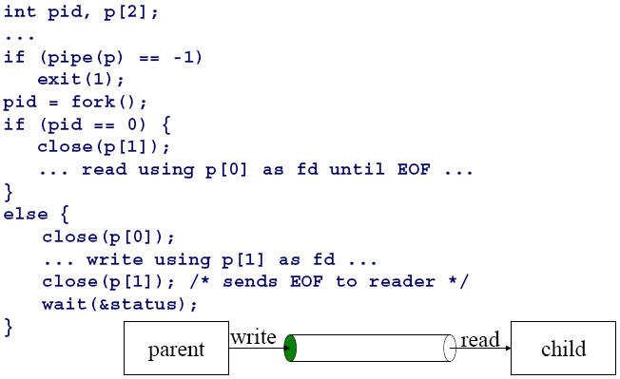
Pipe Example
child
parent

Slide 58
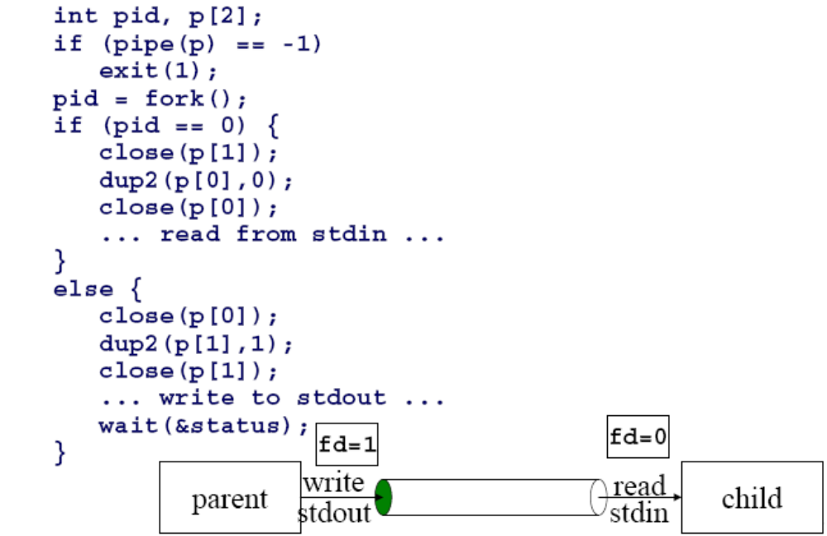
Pipes and Stdio
child makes stdin (0)
the read side of the pipe
parent makes stdout (1)
the write side of the pipe

Slide 59
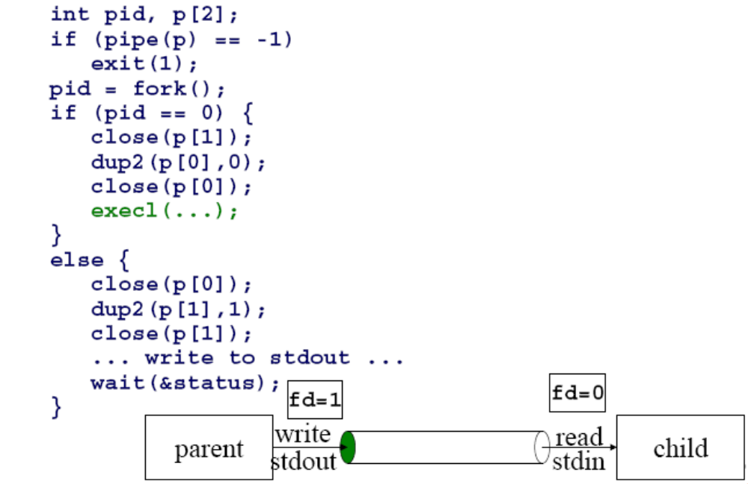
Pipes and Exec
child process
invokes a new program

Slide 60
Open Files Representation
Assume that there was something like this in program
  FILE *in_file;
  // open a file
  in_file = fopen("list.txt", "r");
in_file is a file descriptor
File Descriptor Table
stdin
0
1
2
3
4
stdout
stderr
in_file

Slide 61
Open Files Representation
Each
Open Each Unix process should have the following three file descriptors:
Integer value | Name | <unistd.h> symbolic constant | <stdio.h> file stream
0 | Standard input | STDIN_FILENO | stdin
1 | Standard output | STDOUT_FILENO | stdout
2 | Standard error | STDERR_FILENO | stderr

Slide 62
Open Files Representation
Assume that there was something like this program
  FILE *in_file;
  // open a file
  in_file = fopen("list.txt", "r");
In a fork what gets copied is the file table;
  Each entry points to an area of memory with information about a file
Thus the parent and child point to the same open files
File table
stdin
0
1
2
3
4
stdout
stderr
in_file

Slide 63
Open Files Representation
Terminal
File Descriptor table
Access
Info
stdin
fd0
fd1
fd2
fd3
fd4
stdout
stderr
Disk Info
Access
Info
How do processes share information?

Slide 64
Pipes
We can think of pipes as a special file that can store a limited amount of data in a first-in-first-out (FIFO) manner
One process will write to the pipe (as if it were a file), while another process will read from the pipe
The system provides the synchronization between writing and reading processes

Slide 65
Pipes
Pipes can be used between processes that have a common ancestor
Typical use:
  Pipe created by a process
  Process calls fork()
  Pipe used between parent and child
  Allows for communication between processes

Slide 66
Pipes
By default, if a writing process attempts to write to a full pipe, the system will automatically block the process until the pipe is able to receive the data
Likewise, if a read is attempted on an empty pipe, the process will block until data is available
In addition, the process will block if a specified pipe has been opened for reading, but another process has not opened the pipe for writing

Slide 67
Creating a Pipe
        #include <unistd.h>
        int pipe(int filedes[2]);
Returns 0 if ok, -1 on error
Returns two file descriptors
  filedes[0] is open for reading
  filedes[1] is open for writing
  Output of filedes[1] is input to filedes[0]

Slide 68
Example
#include <unistd.h>
#include <stdio.h>
int main(void){
int n; // track of num bytes read
int fd[2]; // hold fds of both ends of pipe
pid_t pid; // pid of child process
char line[80]; // hold text read/written

Slide 69
Continued …
if (pipe(fd) < 0) // create the pipe
perror("pipe error");
if ((pid = fork()) < 0) { // fork off a child
perror("fork error");
} else if (pid > 0) { // parent process
close(fd[0]); // close read end
write(fd[1], "hello world\n", 12); // write to it
}…

Slide 70
continued
else { // child process
close(fd[1]); // close write end
n = read(fd[0], line, 80); // read from pipe
write(1, line, n); // echo to screen
}
exit(0);
}

Slide 71
After the pipe() call
0
stdin
1
stdout
2
stderr
3
4
filedes 0 1
5
3 4

Slide 72
The Process Calls fork()‏
0
stdin
0
stdin
1
stdout
1
stdout
2
stderr
2
stderr
3
3
4
4
5
5
Child
Parent

Slide 73
After Calling Fork,
Close the read end in one process
Close the write end in the other process

Slide 74
Parent Writing to Child
0
stdin
0
stdin
1
stdout
1
stdout
2
stderr
2
stderr
3
3
X
4
X
4
5
5
Child
Parent

Slide 75
Child Writing to Parent
0
stdin
0
stdin
1
stdout
1
stdout
2
stderr
2
stderr
3
X
3
4
4
X
5
5
Child
Parent

Slide 76
After One End of the Pipe is closed …
Reading from a empty pipe whose write end has been closed returns 0 (indicating EOF)
Writing to a pipe whose read end has been closed generates a SIGPIPE signal
  If we ignore the signal or catch and return, handler returns -1, and errno set to EPIPE

Slide 77
Pipe Capacity
The OS has a limit on the buffer space used by the pipe
  If you hit the limit, write will block

Slide 78
dup() and dup2
#include <unistd.h>
int dup(int filedes);
int dup2(int filedes, int filedes2);
Both will duplicate an existing file descriptor
dup() returns lowest available file descriptor, now referring to whatever filedes refers to
dup2() - filedes2 (if open) will be closed and then set to refer to whatever filedes refers to

Slide 79
Implementing I/O Redirection
How does a shell implement I/O redirection?
  ls > foo.txt
  By calling the dup2(oldfd,newfd) function
    Copies descriptor table entry oldfd to entry newfd
File Descriptor table
before dup2(4,1)
File Descriptor table
after dup2(4,1)
stdin
fd0
fd1
fd2
fd3
fd4
stdin
fd0
fd1
fd2
fd3
fd4
stdout
a
stdout
b
stderr
stderr
b
b

Slide 80
Example
int main(int argc, char **argv) {
int fds[2];
int pid;
/* attempt to create a pipe */
if (pipe(fds)<0) {
perror("Fatal Error");
exit(1);
}

Slide 81
Example
/* create another process */
pid = fork();
if (pid<0) {
perror("Problem forking");
exit(1);
} else if (pid>0) {
/* parent process */
close(fds[0]);
/* close stdout, reconnect to the writing end of the pipe */
if ( dup2(fds[1],STDOUT_FILENO)<0) {
perror("can't dup");
exit(1);
}
execlp("ps","ps","-le", NULL);
perror("exec problem");
exit(1);

Slide 82
Example
} else {
/* child process */
close(fds[1]);
if (dup2(fds[0],STDIN_FILENO) < 0) {
perror("can't dup");
exit(1);
}
execlp("sort","sort",NULL);
perror("exec problem");
exit(1);
}
return(0);
}

Slide 83
A Shell
A shell will perform the following tasks:
  Display a prompt
  Read a command line from the terminal
  Start a background process to execute the command
  Display another prompt and go back to step 1

Slide 84
A Shell (cont.)
A shell will perform the following tasks:
int main()
{
void background( char *command );
for( ; ; )
{
printf(“ your shell prompt\n”);
readLineOfInput();
parseInput();
background( command );
}
return;

Slide 85
Summary
The fork, wait, exec, pipe, dup2 gives you all the functionality for creating a shell
Not just shells
Example: Apache servers forks processes to handle requests

